Slide 1

Agile/CNA Session
Pied Piper Program 7th June 2017
Alberto Ramos
@AlbertoSyd

Slide 2

Agenda
Introduction:
Cloud Native Apps
DevOps, Agile
Labs:
Cloud Native App on Pivotal Cloud Foundry
PaaS – Structured vs Unstructured
Docker Tutorial
Notes:
Mention the Digital Transformation

Slide 3

First some Context
Technology
Process
People
Application
Business Service

Slide 4

How Successful are Software Projects?
18% of software projects are considered "failed“
43% "challenged"
39% actually succeeding
-- 2012 study by The Standish Group.
Unhappy Customers
Unhappy Developers

Slide 5

What is required?
Need to scale quickly up and down
Need to patch without disruption
Need to withstand infrastructure failures
The can be moved easily between clouds
Cheaper to deploy and run
a.k.a CNA’s (Cloud Native Applications)

Slide 6
Cloud Native Apps

Slide 7

What makes a CNA different?
Operate at much greater scale on much more data
Use a more varied backend options, ex: NoSQL
Open Source components at all Levels
Provide reliability at software level
Like to treat infrastructure as code

Slide 8
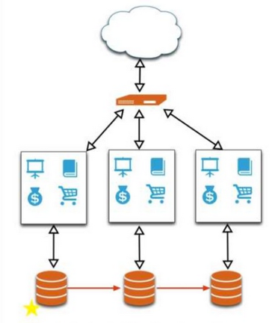
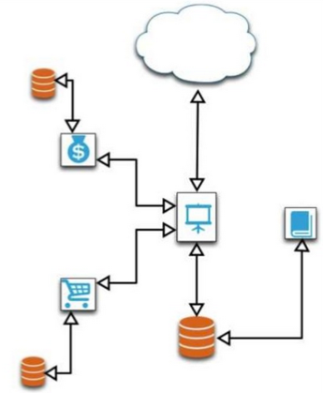
What makes a CNA different?
Tend to be built on Microservices
Communicate through standardized message channels

Slide 9
How do they achieve it? 12-Factors
Codebase: Single Codebase with many branches tracked In revision control, many deploys
Dependencies: Explicitly declare and isolate dependencies
Config: Store config in the environment: credentials, resource
Backing Services: Treat backing services as attached resources
Build, Release, Run: Strictly separate build and run stages. The heavy lifting happens at Build
Processes: Execute the app as one or more Stateless processes
Notes:
http://www.clearlytech.com/2014/01/04/12-factor-apps-plain-english/
https://www.ctl.io/blog/post/appfog-and-twelve-factor-apps-explained/

Slide 10
How do they achieve it? 12-Factors
Port Binding: Export services via port binding. Use a URL
Concurrency: Use lots of (scaled-out) little processes (“microservices”) to increase concurrency
Disposability: Maximize robustness with fast startup and graceful shutdown
Dev/Prod Parity: Keep dev/staging/prod as similar as possible. Intuitive but important in a world of very fast release cycles
Logs: Treat logs as event streams. Consolidate and use them
Admin Processes: Run admin/management tasks off a box in the production environment that is identical to production
Notes:
http://www.clearlytech.com/2014/01/04/12-factor-apps-plain-english/
https://www.ctl.io/blog/post/appfog-and-twelve-factor-apps-explained/

Slide 11
How do they achieve it? 12-Factors
Ex: GitHub
Codebase
Dependencies
Config
Backing services
Build, release, run
Processes
Port binding
Concurrency
Disposability
Dev/Prod parity
Logs
Admin processes
Store in the environment
Notes:
http://www.clearlytech.com/2014/01/04/12-factor-apps-plain-english/
https://www.ctl.io/blog/post/appfog-and-twelve-factor-apps-explained/
Codebase: One Codebase Tracked In Revision Control, Many Deploys
Dependencies: Explicitly Declare And Isolate Dependencies
Config: Store Config In The Environment
Backing Services: Track Backing Services As Attached Resources
Build, Release, Run: Strictly Separate Build And Run Stages
Processes: Execute The App As One Or More Stateless Processes
Port Binding: Export Services Via Port Binding
Concurrency: Scale Out Via The Process Model
Disposability: Maximize Robustness With Fast Startup And Graceful Shutdown
Dev/Prod Parity: Keep Development, Staging, And Production As Similar As Possible
Logs: Treat Logs As Event Streams
Admin Processes: Run admin /management tasks as one-off Processes

Slide 12
Github Tutorial
No Point in reinventing the wheel:
https://guides.github.com/activities/hello-world/
Notes:
http://www.clearlytech.com/2014/01/04/12-factor-apps-plain-english/
https://www.ctl.io/blog/post/appfog-and-twelve-factor-apps-explained/

Slide 13
DevOps

Slide 14
What about DevOps?
First two famous quotes:
I didn’t change anything!
-- every developer
SPEED
, ever
vs
Well the environment didn't change!
-- every ops person, ever.
RELIABILITY

Slide 15
What is DevOps?
A Culture that emphasizes
Collaboration/communication between Dev and QA and IT Ops
Automating the process of software delivery and infrastructure changes

Slide 16
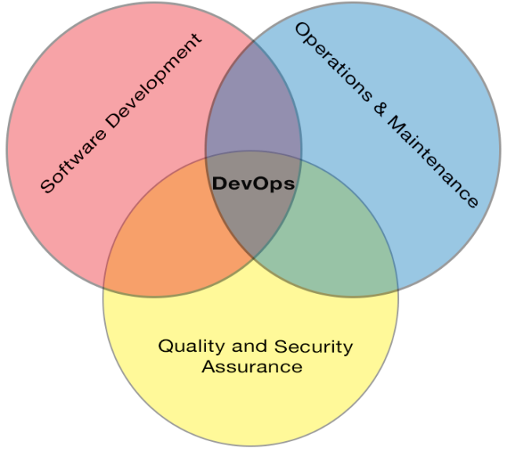
Advantages of DevOps
Better documentation
Better logging
Faster issue resolution
Smoother deployments
Better code + Better support = Successful Projects

Slide 17
Agile

Slide 18
Agile
You can't gather all the requirements up front
The requirements you do gather will change
There is always more to do than time and money will allow
-- The Agile Samurai, J. Rasmusson

Slide 19
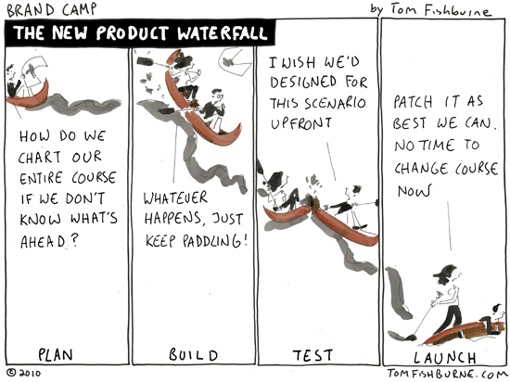
Traditional SDLC
Requirements
Design
Implementation
Verifications
Maintenance

Slide 20


Agile Manifesto
Individuals and Interactions
Processes and Tools
Working Software
Comprehensive Documentation
Customer Collaboration
Contract Negotiation
Responding to Change
Following a Plan

Slide 21
Agile Concepts – Iterative Dev
Iterative and Incremental development
Focus on MVP (Minimum Viable Product)
Welcome changing requirements, even late in development
Notes:
12 Principles of Agile
https://www.linkedin.com/pulse/12-agile-manifesto-principles-simply-explained-jacob-aliet-ondiek
https://www.scrumalliance.org/community/articles/2013/november/the-agile-manifesto-principles-what-do-they-mean

Slide 22
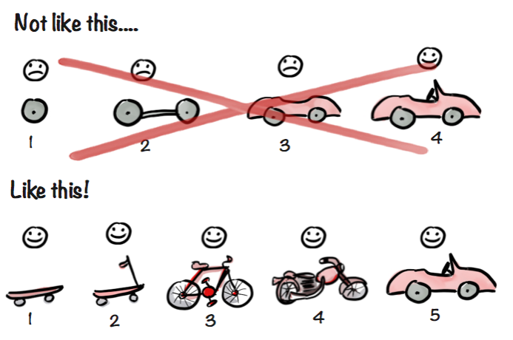

Slide 23
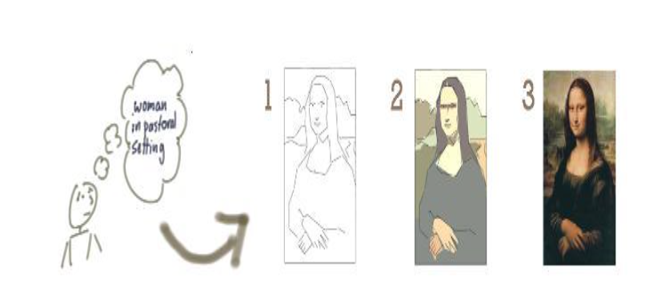
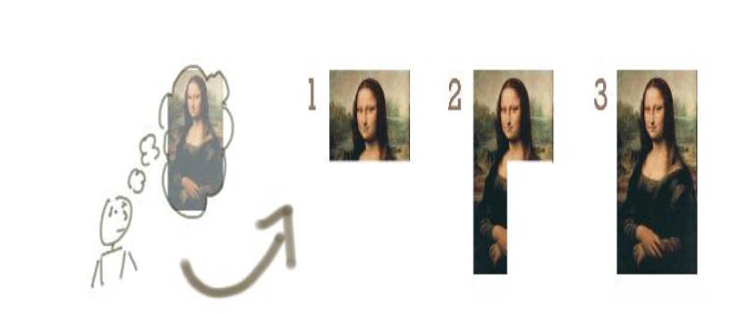
Like This

Slide 24
Not Like This

Slide 25
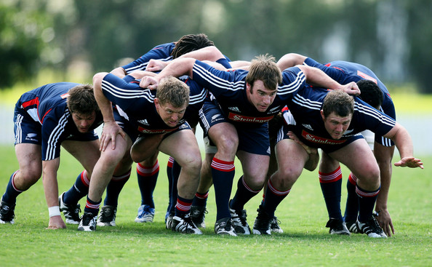
Agile Concepts - People
AGILE SCRUM
Self organizing teams
Business and developers work together = SCRUM
Product Owner: Owns the backlog, prioritizes
Scrum Master: Just a facilitator, with no management authority. Removes roadblocks
Whole team is responsible for Planning and Scheduling
Development Team
Notes:
12 Principles of Agile
https://www.linkedin.com/pulse/12-agile-manifesto-principles-simply-explained-jacob-aliet-ondiek
https://www.scrumalliance.org/community/articles/2013/november/the-agile-manifesto-principles-what-do-they-mean

Slide 26
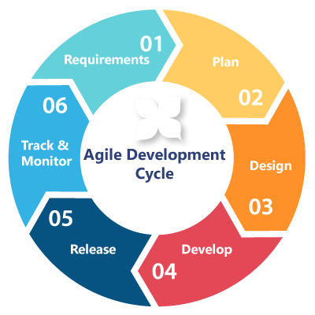
Agile Concepts – Process I
Continuous delivery of ‘working’ software
In short cycles called Sprints
1-4 weeks duration, typically 2
Start with ‘sprint planning session’
Daily Stand-up (done, issues, next)
‘Walk the board’
End with ‘sprint retrospect’ and demo
Notes:
12 Principles of Agile
https://www.linkedin.com/pulse/12-agile-manifesto-principles-simply-explained-jacob-aliet-ondiek
https://www.scrumalliance.org/community/articles/2013/november/the-agile-manifesto-principles-what-do-they-mean

Slide 27
Agile Concepts – Process II
User stories/Epics
As a {x}, I want {y} in order to {z}.
Product Backlog
Agile Board / Scrum Board
Release Backlog → Workflow → ‘Done pile’
Video: “Scrum in under 10 minutes”
Scrum vs ‘Kanban’ → service and support
Notes:
12 Principles of Agile
https://www.linkedin.com/pulse/12-agile-manifesto-principles-simply-explained-jacob-aliet-ondiek
https://www.scrumalliance.org/community/articles/2013/november/the-agile-manifesto-principles-what-do-they-mean

Slide 28
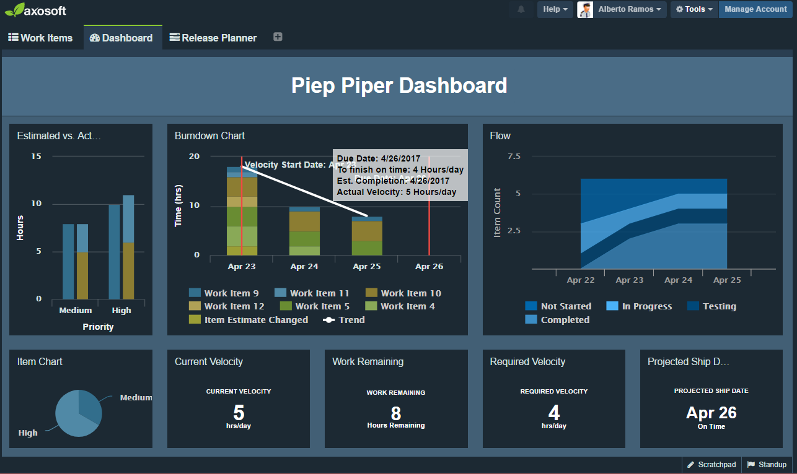
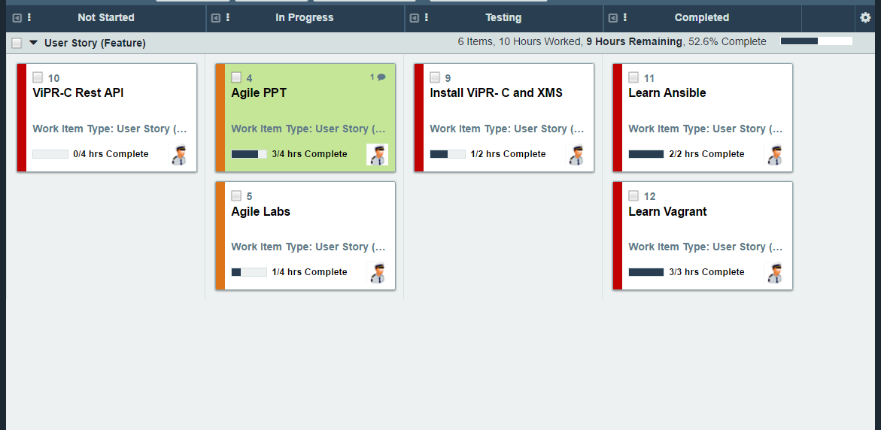
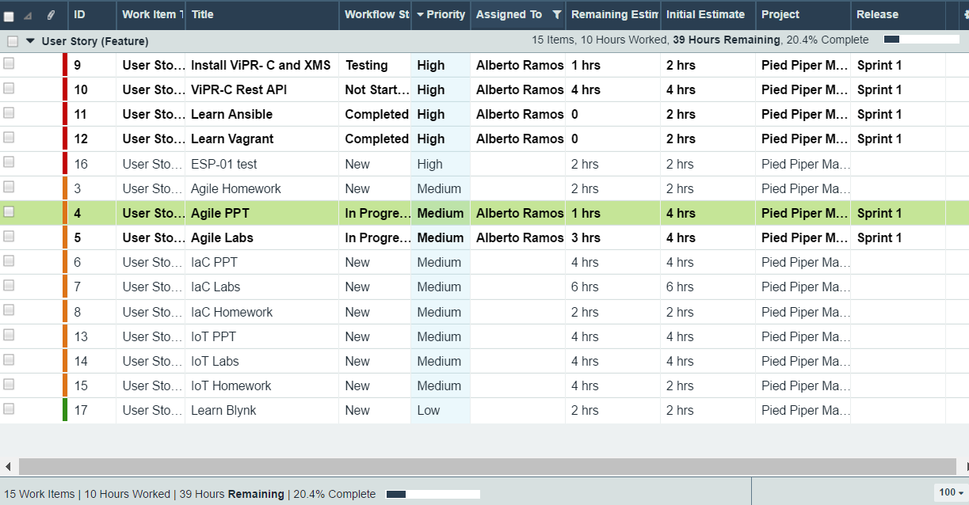
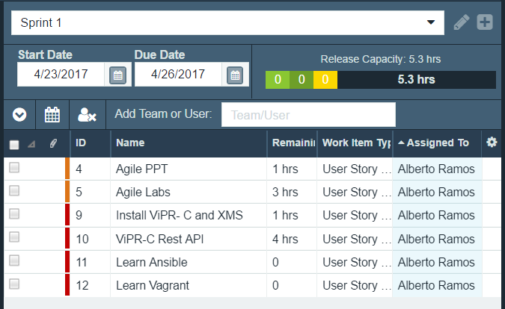
Agile Concepts – Tools
Ex: Atlassian Jira, Axosoft OnTime
Story Points vs Time
Integrate with Github, BitBucket
Let’s see some screenshots
Notes:
12 Principles of Agile
https://www.linkedin.com/pulse/12-agile-manifesto-principles-simply-explained-jacob-aliet-ondiek
https://www.scrumalliance.org/community/articles/2013/november/the-agile-manifesto-principles-what-do-they-mean

Slide 29
RECAP
Technology
Process
People
Agile
DevOps
Hey, hold on!
What about this?

Slide 30
CNA on PCF Labs

Slide 31
Pre-requisites - I
Accounts to open: Github, ECS Test Drive, PCF
https://github.com/join
https://portal.ecstestdrive.com/Account/Register
https://run.pivotal.io/pricing/ ($87 free credit)
https://aws.amazon.com/free/
Tutorials to follow:
https://www.codecademy.com/learn/python (Lessons 1 to 8)
http://htmldog.com/guides/html/beginner/
https://www.tutorialspoint.com/html/html_style_sheet.htm

Slide 32

Pre-requisites - II
Install: CF-CLI, Python2.7, N++, S3browser, Postman
https://www.python.org/ftp/python/2.7.12/python-2.7.12.msi
https://cli.run.pivotal.io/stable?release=windows64-exe&source=github
http://s3browser.com/download/s3browser-6-5-9.exe
http://download.virtualbox.org/virtualbox/5.1.22/VirtualBox-5.1.22-115126-Win.exe
https://download.docker.com/win/stable/DockerToolbox.exe
https://notepad-plus-plus.org/repository/7.x/7.4.1/npp.7.4.1.Installer.x64.exe
Verify that the following directories are in the PATH:
- C:\Python27\
- C:\Python27\Scripts\
- C:\Program Files\Cloud Foundry\
Disable firewall in your laptop during the labs

Slide 33
Agenda
Introduce SE Conference App
Setup the Scrum Board and Backlog
Sprint 1: Web, PCF
Sprint 2: NoSQL database
Sprint 3: Object storage
PaaS
Docker Lab

Slide 34
Introducing the SE Conference app
Developed for the SE Conference 2016
Features
View Agenda, review sessions, get social, survey
http://asec16.cfapps.io ← Optimized for mobile
http://anzforum.cfapps.io ← Optimized for mobile
https://github.com/cermegno

Slide 35
Doing it the Scrum way
User stories → Product Backlog
Create Scrum board
Columns:
Not started, Upskill, In Progress, Complete
Sprint planning
… and don’t forget to stand up!

Slide 36
Sprint 1 – Web
Quick HTML refresher
<HTML> <header> <body>
<h1> </h1> <h2> </h2> …
<i></i> <b></b> <u></u> <br> <hr>
<a href=“http://url/etc”> some text here </a>
<img src=“image.gif”> <img src=“images/image.gif”>
<ul><li><li</ul> <ol><li><li</ol>
<table><tr><td>
CSS

Slide 37
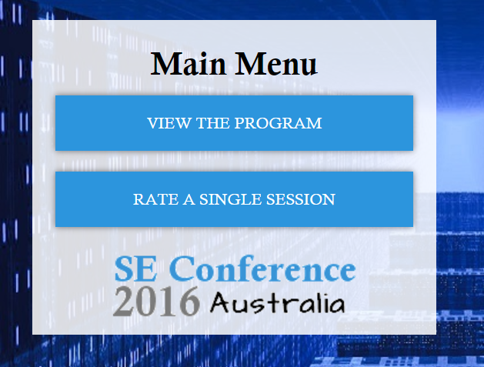
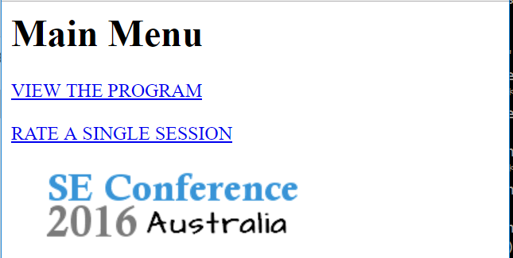
Sprint 1 – Web
With and without CSS

Slide 38
Sprint 1 – Hello Python … and Flask
Go to https://github.com/cermegno
Clone “Geekday-Lab1” repo to your laptop
Install “flask”: pip install flask ← Note dependencies
Open “step1.py” it with IDLE (right-click)
The instructor will explain what you are looking at
Run it by pressing F5
Open a browser and go to http://127.0.0.1:5000
Notes:
Pay attention to the fact that PIP is resolving the packages flask relies upon and installing them in the necessary order before installing “Flask”. This order is important when telling Cloud Foundry what our app requires to run

Slide 39
Sprint 1 – More advanced Flask
Examine different ways of returning html (step2 and step3)
Create a link to new page that shows floor plan (step4.py)
Read “sessions.txt”
dump all session info to the console(step5.py)
Now return a HTML agenda (step6.py)
Did all sessions display well?
Introducing “epoch” time (step7.py)
Use “sessions2.txt”
Display time in human readable format
TIP: import time

Slide 40
Sprint 1 – More advanced Flask
Two page solution (step8.py)
First page displays only session names as links
If user clicks, a page opens to show all specific session info
You must learn how to pass a parameter with a Flask call
TIP: You can use the “session id” to let the second function know what session’s details are required
Rename “step8.py” to “app.py”

Slide 41
Sprint 1 – Hello … Cloud Foundry
Time for magic !! Just type the magic words:
cf login -a https://api.run.pivotal.io
cf push your_app_name
Open in a browser (http://your_app_name.cfapps.io)
Lower RAM to 64MB … that’s how you get billed !!
You can do it from the GUI or CLI. Type “cf” to see options
Now scale it up to 2 or 3 instances (GUI/CLI):
You can watch the UUID change as you access all instances

Slide 42
Sprint 1
Pause for a moment! Think about what just happened
Display the status of your app from GUI and CLI
How do you access the logs from the CLI?
Can you display errors only
If instance 2 has a problem how do you restart it?
What’s the “requirements.txt” file?
pip freeze
pipdeptree
Notes:
Did you configure a DNS server? A load balancer? A port forwarding?
The logs from both instances are being aggregated. It would be another product to do that

Slide 43
Sprint 1 - is Over
It is time for “Retrospect”
And time to have a break
… Well Done !!!

Slide 44
Sprint 2 – NoSQL
All apps need a database!
We will use NoSQL = Not Only SQL
No fixed schema
More scalable
Handle unstructured data
Cheaper to manage
Can have duplicated data
Eventual consistency
Worse data integrity
Harder ACID compliance
Notes:
SQL databases in contrast normalize the data (no duplicates), better with data integrity (you cannot delete a customer and leave his orders behind in the database, the are ACID (transactions are all or nothing)
https://www.thoughtworks.com/insights/blog/nosql-no-problem-intro-nosql-databases
https://martinfowler.com/articles/nosql-intro-original.pdf
https://www.youtube.com/watch?v=Eay2Ylhuf0k
https://martinfowler.com/articles/nosqlKeyPoints.html
https://www.thoughtworks.com/insights/blog/nosql-databases-overview

Slide 45
Sprint 2 – NoSQL
Types:
Key-Value (Redis) User sessions and profiles
Document (MongoDB) Blogs, CMS, heavy read analytics
Columnar (Cassandra) Heavy write analytics, log aggregation
Graph (Neo4j) Recommendations
Map-Reduce (Hadoop)
Polyglot persistence
Notes:
https://www.thoughtworks.com/insights/blog/nosql-databases-overview
https://www.thoughtworks.com/insights/blog/nosql-no-problem-intro-nosql-databases
https://martinfowler.com/articles/nosql-intro-original.pdf
https://www.youtube.com/watch?v=Eay2Ylhuf0k

Slide 46
Sprint 2 – Redis
In Memory
Fast. Often used for caching
But with built-in replication and on-disk persistence
Key-value, List, Set (unique and unordered) and Hash
Redis tutorial
https://try.redis.io/
Discuss data type and name scheme to accomplish …
Notes:
To-do list for an individual. Is the order important? List or keys
Skills you bring to the team as an individual
Skills we have as a team
Readings from your home temperature sensor
Readings from many temperature sensor in NSW
Readings from multiple dual temperature/humidity sensors in NSW
Track attendance to Tech Summit sessions

Slide 47
Sprint 2 – Cloud Foundry Services
Examine the environment variables
In PCF, go to “Bind a service”
Explore Marketplace and discuss the options
Pay attention also to RabbitMQ → Microservices
What would it take to do this in an unstructured PaaS
Select the free REDIS version (only 1 free per space)
Examine the environment variables again. Any difference?
Make a note of Redis credentials (host, port and password)
Notes:
The free Redis version from PCF allows us up to 30 connections but sometimes is not enough
By doing this first (even if we don’t push the app) everyone gets his own Redis instance

Slide 48
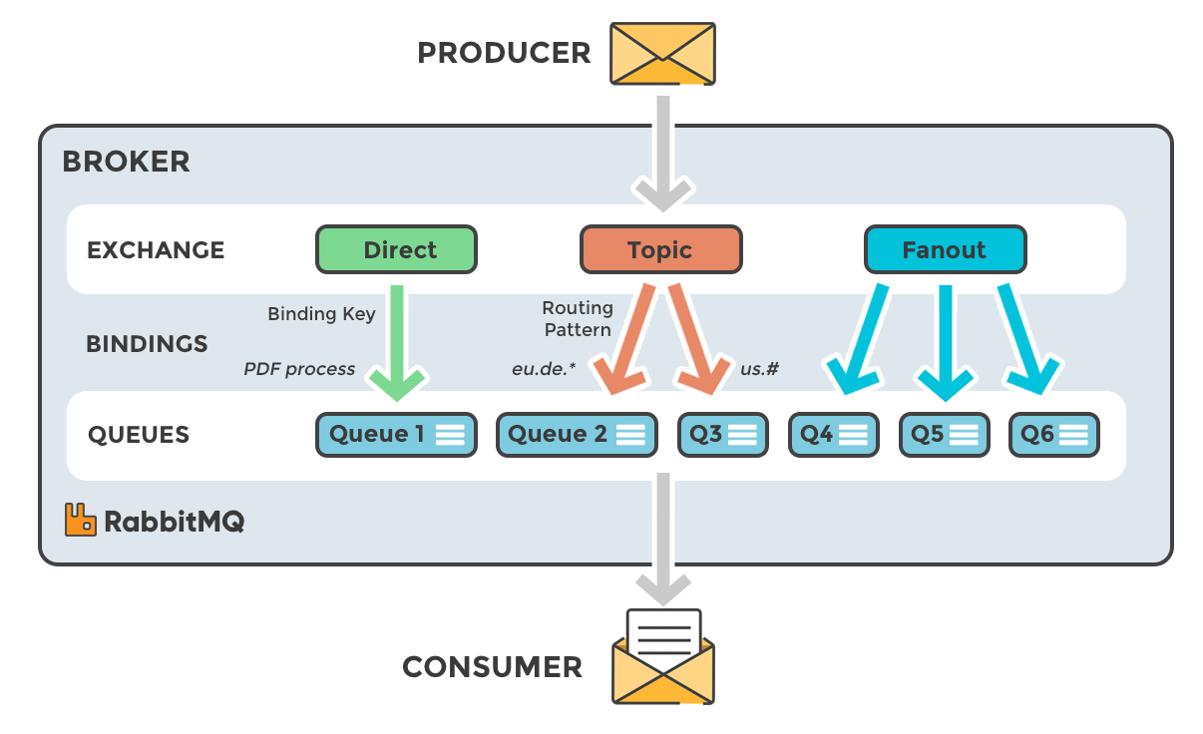
Sprint 2 – CF Services - RabbitMQ
Notes:
The free Redis version from PCF allows us up to 30 connections but sometimes is not enough
By doing this first (even if we don’t push the app) everyone gets his own Redis instance

Slide 49
Sprint 2 – Redis with Python
Install “redis”: pip install redis
Clone https://github.com/cermegno/Redis-test repo
Open Redis-test.py with IDLE
Find credentials and connect to your Redis instance
Script: create/display/modify/delete keys and counters
Script: create/display/modify/delete lists
Script: create/display/modify/delete hashes

Slide 50
Sprint 2 – Store HTML form data in Redis
Let’s examine (step1.py)
This webpage has a form with a text box
templates/survey.html
Let’s build a small survey with a HTML form
Commercial/Enterprise (Radio button)
AU/NZ state (Drop-down menu)
Feedback (Text box)
Dump the survey response to console or HTML (step2.py)

Slide 51
Sprint 2 – Store HTML form data in Redis
Now store the data from the form in Redis (step3.py)
It’s ok for now to overwrite the same key over and over
read it back and dump it into the console
Use a Redis counter and use it create different key name every time the form is submitted (step4.py)
Create extra page that dumps all surveys received (step5.py)

Slide 52
Sprint 2 – Cloud Foundry Services
We are ready to go to Production
Clone https://github.com/cermegno/GeekDay-Lab2
Push it to PCF with the same app name as before
Test it
Notes:
The free Redis version from PCF allows us up to 30 connections but sometimes is not enough
By doing this first (even if we don’t push the app) everyone gets his own Redis instance

Slide 53
Sprint 3 – Object Storage
Cloud Native Apps love “Object storage”!
Object vs File vs Block
No directory tree
Metadata stored along with object
Buckets. Permissions
Access via API (S3, Swift)
Protected by Erasure coding ← Cost savings
What use cases is it good for?
ECS
Namespace. No need for unique bucket names
Strong global consistency
Durability (11 x 9’s, SEC 17-A4 compliant)
Massive scalability
Notes:
https://blog.rackspace.com/introduction-to-object-storage
http://journeytothecloud.net/an-introduction-to-object-storage/
Improved data durability and availability meeting SEC 17-A4 requirements and Federal Common Criteria.
ECS provides 11 x 9's durability and 3 x 9's availability

Slide 54
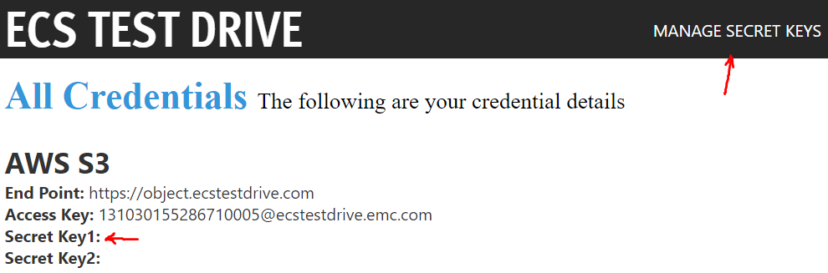
Sprint 3 – Working with ECS
Create a “secret key” in “manage secret keys”

Slide 55
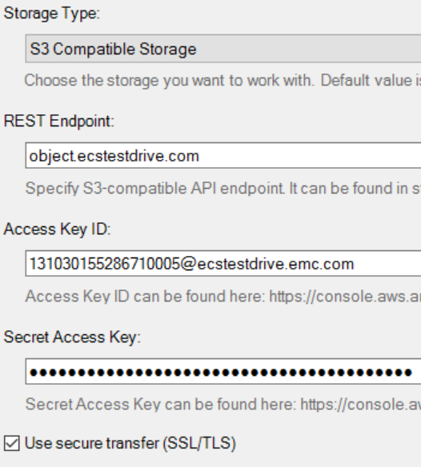
Sprint 3 – Working with ECS
In S3Browser add new account
S3 Compatible
Endpoint without ‘https://’
Tick “SSL/TLS”

Slide 56
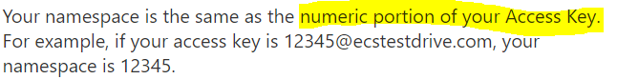
Sprint 3 – Working with ECS
Create a bucket
Upload a photo and then use the preview tab
Pay close attention to bucket and object permissions tab
Download the object from your web browser (HTTP only)
This requires “all users” to have “read” permission
Use http://namespace.public.ecstestdrive.com/bucket/key
Or http://bucket.namespace.public.ecstestdrive.com/key

Slide 57
Sprint 3 – ECS vs AWS S3
Quick tour of AWS S3
Create a bucket and upload a document or a photo
Pay attention to bucket and object permissions
Show it in S3 Browser
Download the object from a web browser (http or https)
http://bucket.s3.amazonaws.com/key

Slide 58
Sprint 3 – ECS in Python
Install “boto”: pip install boto
Clone https://github.com/cermegno/Boto-S3
Open “Boto-S3.py” with IDLE and add your credentials
Script the upload of the image in the directory
Script the list of all keys in the bucket
Script the deletion of image from ECS

Slide 59
Sprint 3 – S3 Permissions
You can create a custom ACL
or use one of these four ‘canned’ policies:
private: Owner gets FULL_CONTROL. No one else has any access rights.
public-read: Owners gets FULL_CONTROL and the anonymous principal is granted READ access.
public-read-write: Owner gets FULL_CONTROL and the anonymous principal is granted READ and WRITE access.
authenticated-read: Owner gets FULL_CONTROL and any principal authenticated as a registered Amazon S3 user is granted READ access.

Slide 60
Sprint 3 – Object metadata
Script the upload of the image with metadata
Script the retrieval of metadata of a key
Discussion points:
How do you search a bucket for keys with specific metadata?
What methods could you use to for example display photos in S3 that were taken by a given photographer?
Notes:
different buckets for different users, add the user name to the key name, keep track in a database

Slide 61
Sprint 3 – Let’s build a photo album
Version 1:
Upload all photos from the images subdirectory
Create a web photo-album with all the photos in a bucket
Version 2:
Prompt for each photo photographer’s name before uploading
Store photographer’s name as metadata
Photo-album must display the name of the photographer

Slide 62
Sprint 3 – Fully featured app
Clone https://github.com/cermegno/SEconference2016
Set environment variables as instructed
Push it to Pivotal Cloud Foundry
Open in a browser http://your_app_name.cfapps.io
Upload a photo … Can you see it with S3Browser?

Slide 63

We are in Production !!!
Now we have to support it
Use all app features and check the logs
Check resource usage in the console
Working remotely? Log on to console from mobile
… Good Job !!!
GO PIPER GO

Slide 64
Platform as a Service

Slide 65
Where Do We Fit?
Technology
Process
People

Slide 66

So where do we fit? Technology? P? P?
PROBLEM
The application provides the resilience
CONSEQUENCE
Backend is less relevant
Focus moves to the compute side
COTS with the “Platform” on top

Slide 67
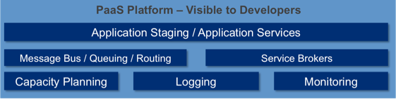

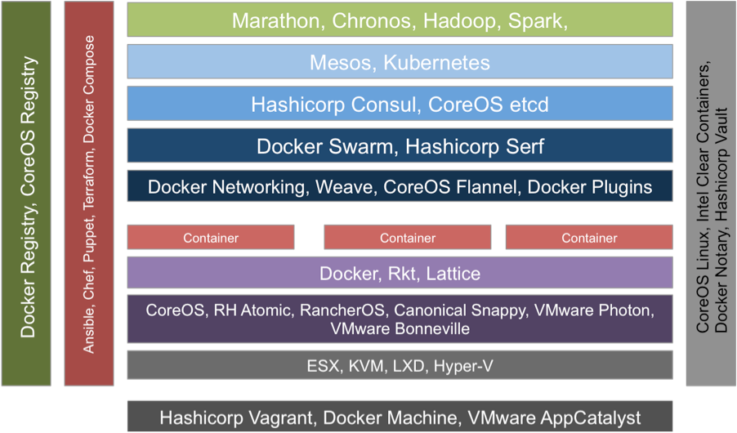
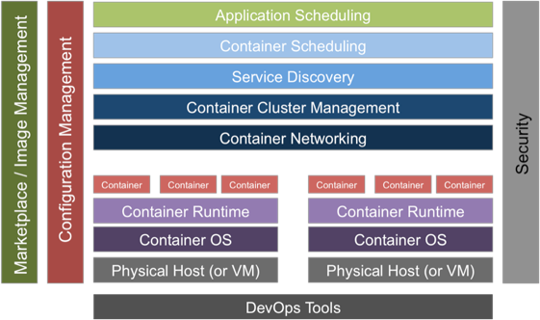
Two Types Of Cloud Native Platforms
Unstructured
Structured
Ultra-flexible
Max Opportunity For Optimization
For Companies Where Platform = Core Competency
Common In SaaS Startups Where There Are Relatively Few, Bespoke Apps
Opinionated
Fastest & Reliable Outcome
Largest Community Of Talent
Common In Enterprise Where There Are Many Apps

Slide 68
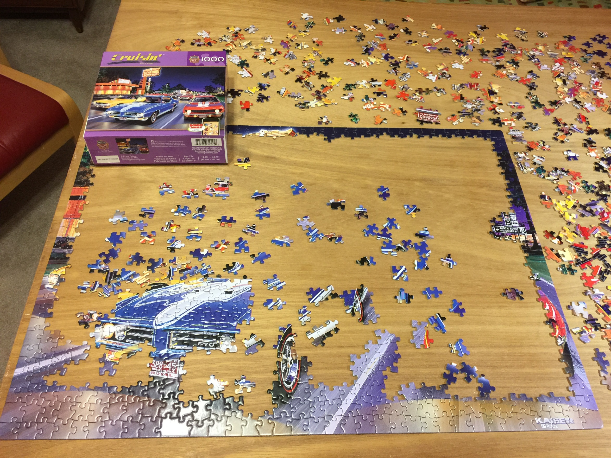
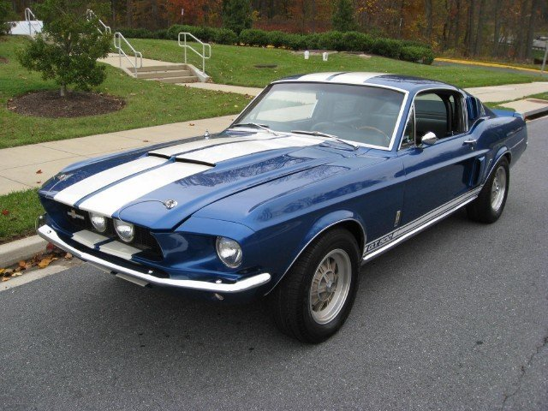
What is REALLY like!

Slide 69

Which Platform Is Right?
Unstructured
Structured
FEW
HOW MANY APPS IN THE ENTERPRISE?
MANY
YES
IS THE PLATFORM A CORE COMPETENCY?
NO

Slide 70


Which PaaS Is Right?
UNSTRUCTURED
USERS
STRUCTURED
USERS
TRADITIONAL
ENTERPRISES

Slide 71
Process for deploying an app: EC2 vs CF
Deploy VM (the easy part - handled by IaaS)
Secure VM (or write some puppet)
Install runtime (with what? rpm? tarball?)
Install dependencies (or write some scripts)
Install application (tarball? RPM? git?)
Start application (how? job engine?)
Modify load balancer (how?)
Modify firewall (how?)
Add health checks (to where? http? tcp? )
Deploying app on CF
cf push app_name

Slide 72
Structured PaaS from DellEMC
On Prem
VxRack
VxRail
Off Prem
Pivotal CF
Virtustream
Notes:
On-Prem: All their incarnation, brownfield (Bonneville), Neutrino, Photon, SDDC

Slide 73
Where are CNA’s in this diagram?
Performance
Performance
In
Memory
DB
VDI
Non
HA
DB
Decision
Support
Transaction
Processing
Video
Stream
App Dev
VM
Infrastructure
CNAs
Email
Lower
Service Level
Home
Directories
Higher
Service
Level
SLA-
SLA+
Web
Content
Big Data
Video
Processing
Content
Mgmt
New
Cloud
Apps
Online
Archive
Backup & Recovery
Capacity
Capacity
Notes:
XIO – scale-out, all flash

Slide 74
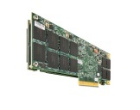

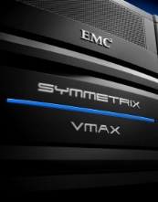






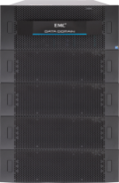
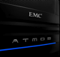
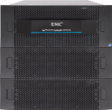
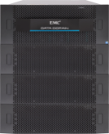
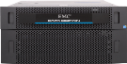
Some Storage Products Still Apply
Performance
Performance
In
Memory
DB
VDI
VMAX
Non
HA
DB
Decision
Support
Transaction
Processing
XtremIO
Video
Stream
App Dev
VM
Infrastructure
VNX
Lower
Service Level
Email
Home
Directories
VPLEX
Higher
Service
Level
SLA-
SLA+
Web
Content
Isilon
Big Data
Recover
Point
Video
Processing
Content
Mgmt
New
Cloud
Apps
Data Domain,
Avamar, & NetWorker
ECS
Online
Archive
Backup & Recovery
Capacity
Capacity

Slide 75
The Battle for Unstructured PaaS
Container platforms have mostly focused on stateless apps
Complex and ever changing
Working hard on making stateful services part of their inventory
The good news is … those represent a large portion of the storage

Slide 76
Some Data Stored Outside the Platform

Slide 77
All Data Stored in the Platform

Slide 78
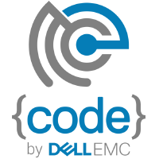


Be an Open Source Advocate
Cloud Foundry & EMC Coder Dojo
Rex-Ray: a storage orchestrator that enables persistent storage inside of containers
RackHD provides bare metal orchestration for application platforms
Many more at: https://codedellemc.com/

Slide 79
Docker Concepts
Image: exec that contains what you need to run app
Container: runtime instance of an image (memory)
Images → Repositories → Registry
Docker Compose
Services: group of containers with same purpose
Stacks: group of services that are orchestrated together
Docker Swarm: cluster of machines running Docker

Slide 80
LAB: Docker Tutorial
Install VirtualBox and Docker Toolbox
Open Docker Quickstart Terminal
$ docker-machine ip default
Go through this 3-part tutorial (alpine, webapps, votingapp)
https://github.com/docker/labs/blob/master/beginner/chapters/alpine.md
A more comprehensive one that includes Docker Swarm
https://docs.docker.com/get-started/

Slide 81
Homework

Slide 82
Homework
Exercise 1 – Pied Piper team website
Go to https://github.com/cermegno/team-website
Create a new branch of the repo. Name it after yourself
Main page has list of Pied Piper members.
Add your name and link to a Flask function that creates your own page
Your page contains: name, hobbies list and ideal holiday description
The fields for the personal page come from the text file provided
Pull request so that the owner merge your changes into repo

Slide 83
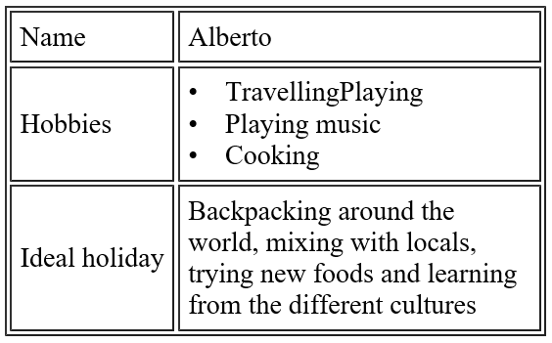
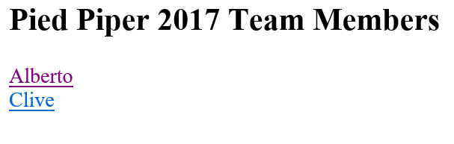
Homework
Exercise 1 – Pied Piper team website

Slide 84
Homework
Exercise 2 – Your own personal food blog
Main page: new post, view blog, total calories to date
“New post” is a form, ex: meal type, calories, meal description. Data stored in Redis
“View Blog” dumps entries by chronological order
(Bonus Points 1) Upload a photo of the dish
(Bonus Points 2) Use a different DB, ex: MongoDB, MySQL
https://realpython.com/blog/python/introduction-to-mongodb-and-python/

Slide 85
Homework
Exercise 2 – Step-by-step
(step1.py) Main menu with “New Meal” option.
Form includes:
Mealtype (type = “radio”)
Calories (type = “number”)
Description (type = “text”)
Store each new meal as a Redis hash
(step2.py) Main menu also includes “View meal blog”
As in previous exercises, firstly dump contents to consoled
then dump them as HTML

Slide 86
Homework
Exercise 2 – Step-by-step
(step3.py) Ensure the blog entries are in chronological order
When listing, Redis returns keys in its own internal order
Need to learn how to sort a list. Does it sort after 9 entries?
(step4.py) Main page needs to display the calories so far
(step5.py) Add date field (form with: type = “date”)
Try it on IE, Microsoft Edge, Chrome, Firefox
(step6.py) Upload a meal photo (use “photo_upload.py”)

Slide 87
Homework
(Optional) Exercise 3 – Docker in AWS ECS
Provision a basic web server Docker container in AWS
You can follow this tutorial:
https://aws.amazon.com/getting-started/tutorials/deploy-docker-containers/

